Slide 1
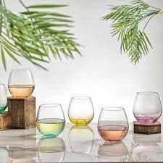
Staring at wine before tasting it …
A data visualization project
by
Saee Kamat
Mentor : Srijit Mukherjee

Slide 2
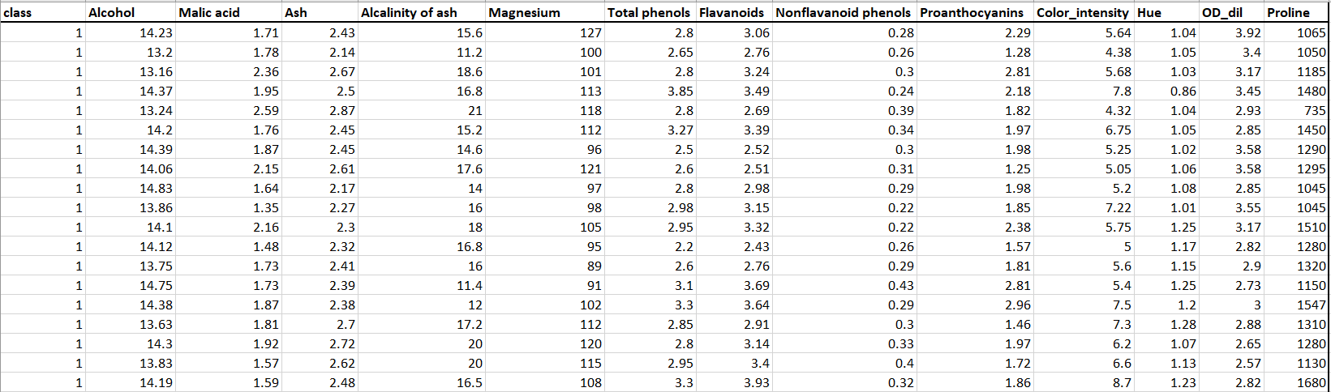
“Wine” dataset from Kaggle

Slide 3
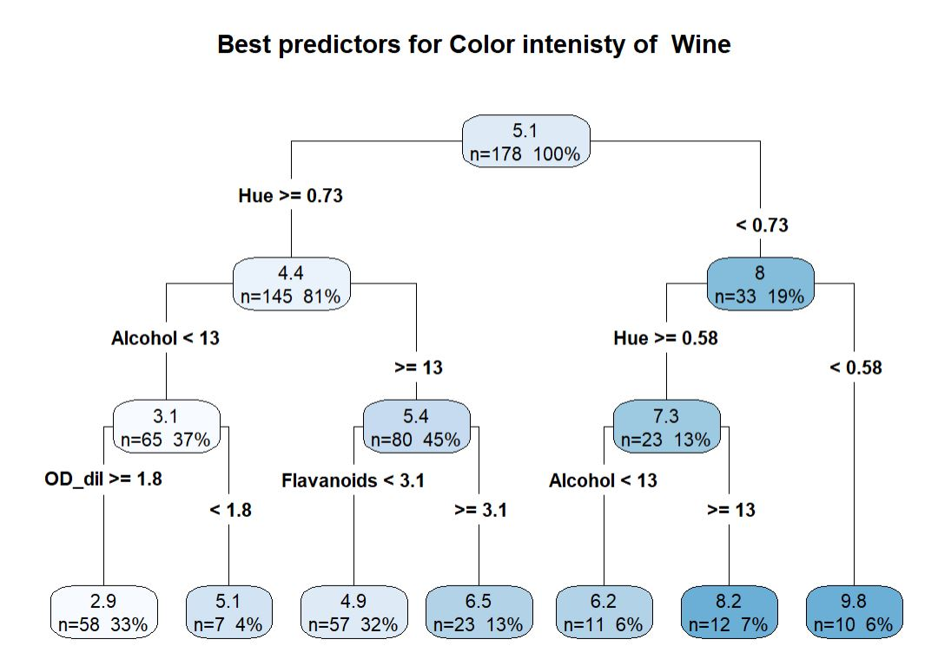
Unsupervised Learning : Finding clusters based on Color intensity

Slide 4
Variables which matter the most are :
Variable | Description
Color intensity | Color intensity of wine measured by optical density at a particular wavelength.
Flavonoids | The concentration of flavonoids in the wine, (mg/L)
Hue | The concentration of flavonoids in the wine, (mg/L)
Alcohol | The alcohol content in the wine,(% )
OD_dil | The ratio of the optical density measured at 280 nm to that measured at 315 nm

Slide 5
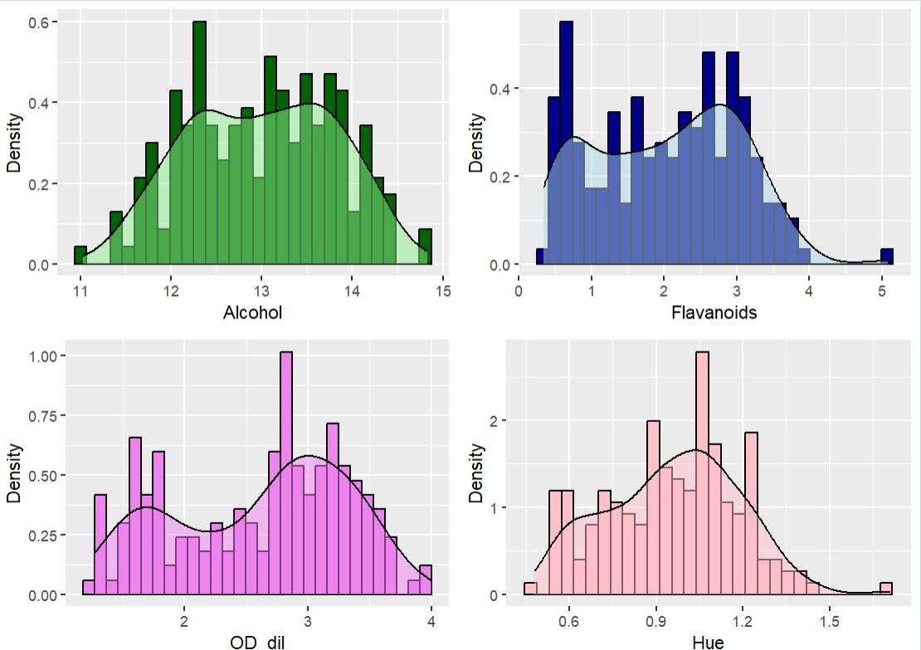
There can be two or more clusters….

Slide 6
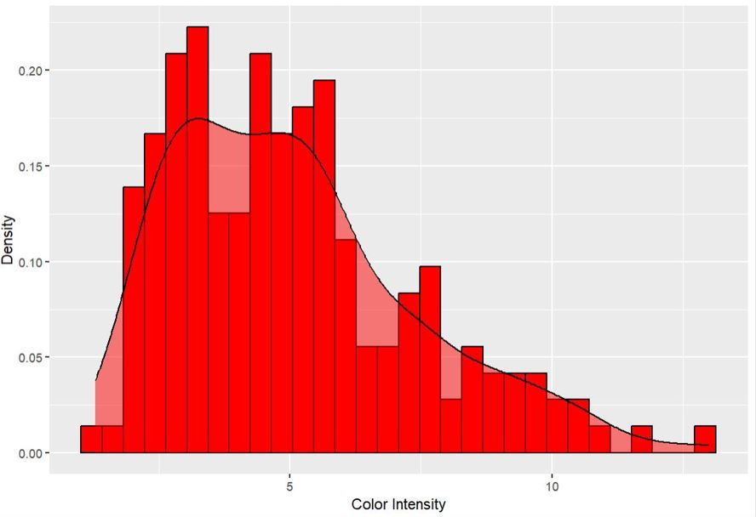
There can be two or more clusters…

Slide 7
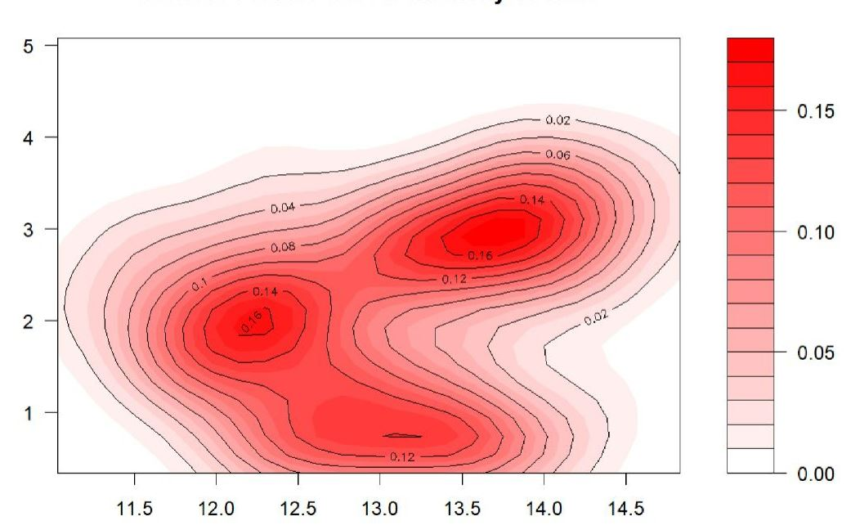
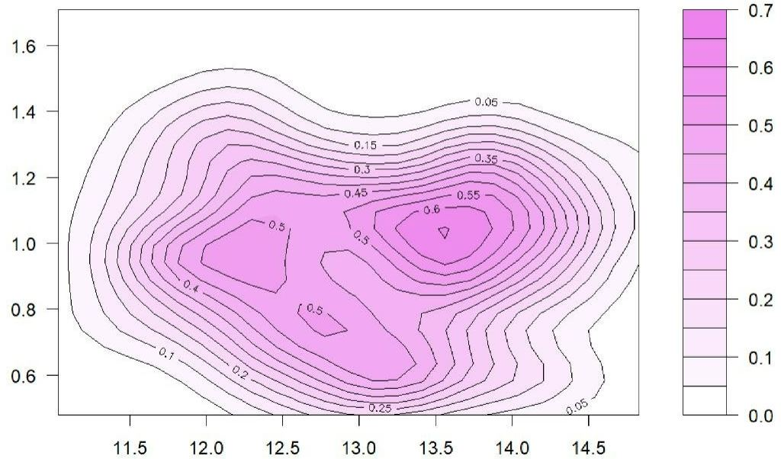
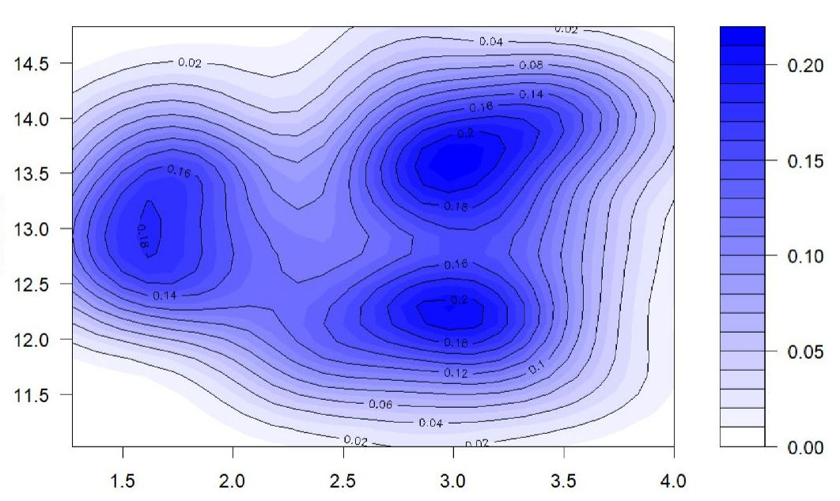
Color Intensity : 3 or more clusters!
Hue
Flavanoids
Alcohol
Alcohol
Alcohol
Darker the shade , greater the intensity!
OD_dil

Slide 8
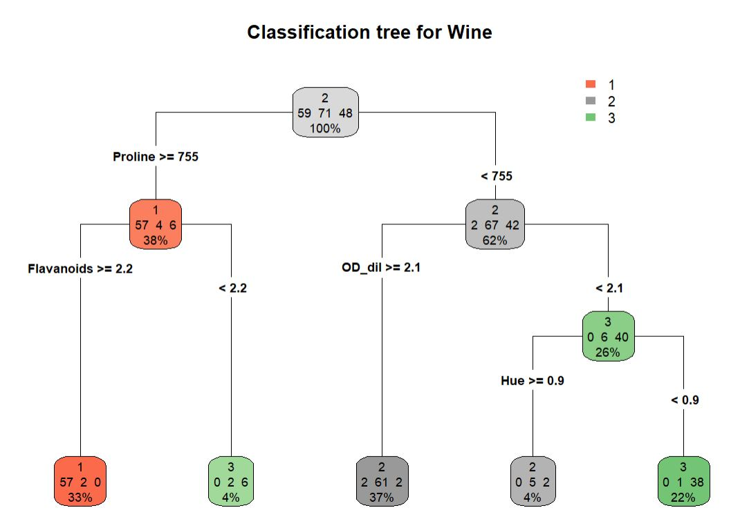
Supervised Learning : Classification of samples into 3 categories
Color intensity is not even included!
Proline : The concentration of proline, an amino acid, (mg/L).

Slide 9
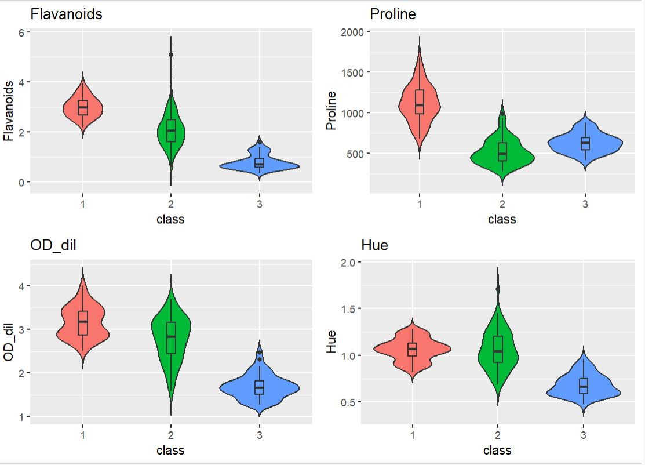
Distributions ..are different!

Slide 10
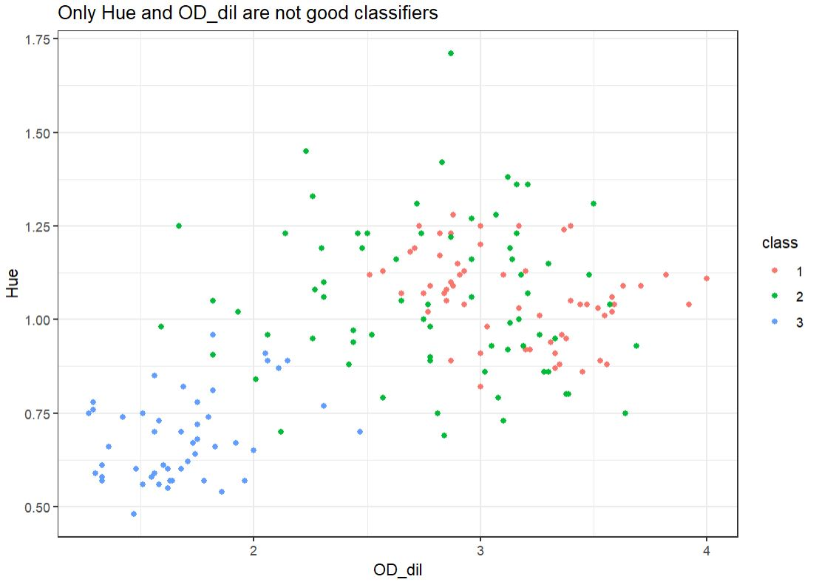
Finding good classifiers …
Class 1 and 2 are mixed
Class 1

Slide 11
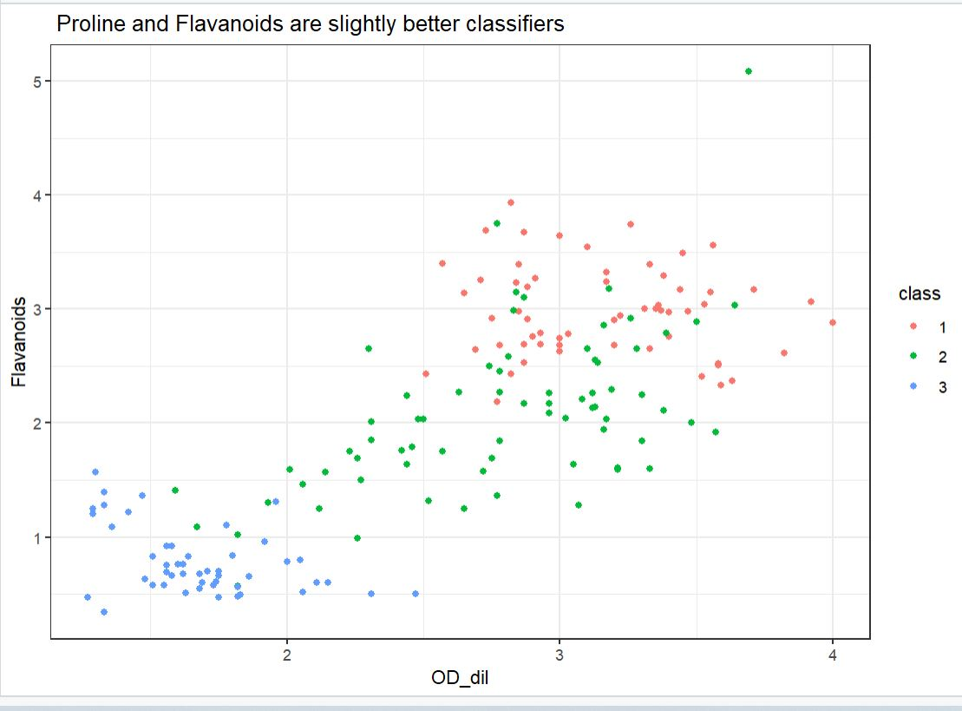
Finding good classifiers …
Class 1
Class 3
Class3

Slide 12
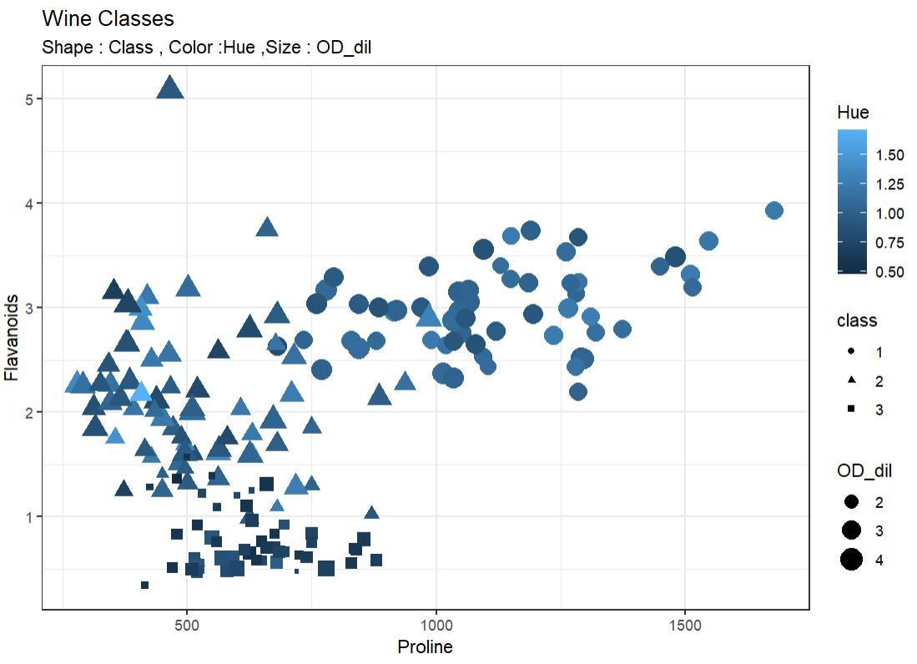
Considering all variables at ones!
Class 3
Class 2
Class 1

Slide 13
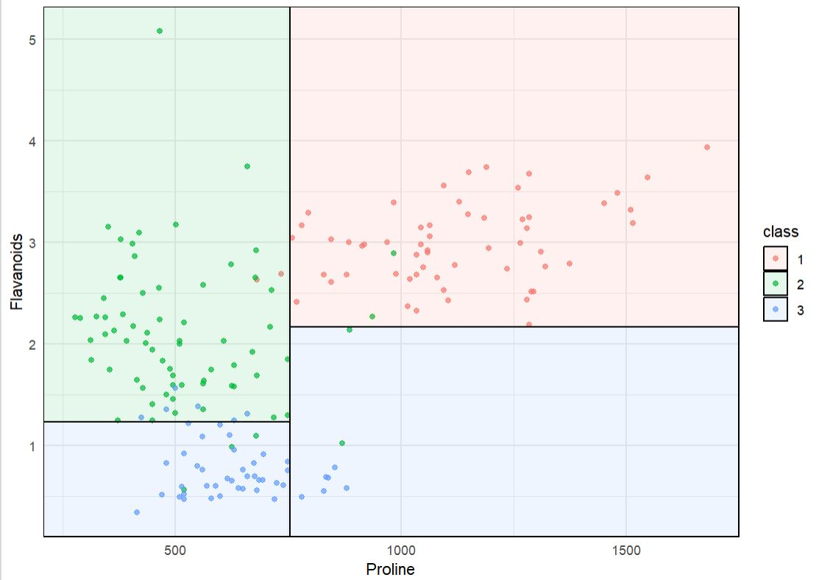
What decision tree is really doing ? The Decision Boundary

Slide 14
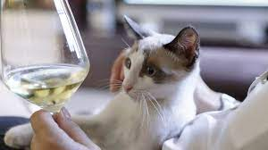
Is staring at wine good enough to classify it ?

Slide 15
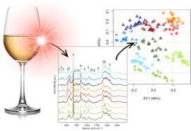
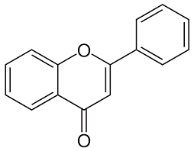
Chemical composition and optical density measures do matter!

Slide 16


